Slide 1

DMV Road Assessment
Sagnick Mukherjee
Data Analyst In Training
Neotia Skill Development Academy

Slide 2
Problem Statement:-
The DMV conducts road tests for applicants seeking a new driver’s license. While some candidates successfully pass, a significant proportion fail, leading to delays and additional costs for both the DMV and the applicants. Understanding the factors that influence pass and fail outcomes can help improve training programs, allocate resources more effectively, and support applicants in being better prepared.
This project analyzes a simulated DMV dataset containing applicant demographics (age, gender, race), training participation, and road assessment indicators. The goal is to explore trends in performance, identify key predictors of success or failure, and build a predictive model that estimates the likelihood of passing the road test.

Slide 3
Objective
To analyze overall pass rates and compare differences across demographic groups (gender, age, race).
To evaluate the impact of training (Advanced, Basic, None) on pass/fail outcomes.
To identify the most significant road assessment indicators influencing success or failure.
To build and test a logistic regression model to predict pass/fail outcomes, and assess its accuracy, precision, recall, and F1-score.
To demonstrate how different cutoff thresholds affect model performance using confusion matrices.
To design interactive dashboards in Power BI that allow dynamic filtering by demographics, training, and test results.
To provide insights and recommendations that could help the DMV improve applicant success rates and training effectiveness.

Slide 4
KPIs for DMV Road Assessment
KPI Name | Description
Overall Pass Rate | Percentage of applicants who successfully passed the DMV road test.
Pass Rate by Gender | Comparison of pass percentages between male and female applicants.
Pass Rate by Race | Distribution of pass outcomes across different racial groups.
Pass Rate by Age Group | Success rate segmented into age ranges .
Impact of Training | Improvement in pass rates for applicants who took Basic or Advanced training compared to those with no training.
Top Failure Indicators | Most common skill/indicator failures (e.g., signals, road signs, mirror usage) contributing to test failure.
Model Accuracy | Percentage of correct predictions made by the logistic regression model.
Precision | Among those predicted to pass, the percentage who actually passed.
Recall (Sensitivity) | Among actual pass cases, the percentage correctly identified by the model.
F1-Score | Harmonic mean of precision and recall, balancing the two metrics.

Slide 5
Overview of Dataset Structure :-
DADV-2-Capstone Project-Group D-Dataset Drivers License Data:-Contains data on applicant’s demographics (age , gender and race), training participation and road assessment indicators.

Slide 6
Data Cleaning & Methodology:-
Key Data Cleaning Process Included:-
Accurate data types of the fields were assigned.
The dataset was thoroughly checked for all the missing values and for duplication of data and no such things were found.
All the numeric fields are converted into numeric datatypes from general datatypes to ensure proper analysis.

Slide 7
Feature Engineering :-
Feature Engineering done in Excel:-
Synthetic Age column generation:-A synthetic Age column was generated by using Generative AI tools and by taking the reference of Age-group column .(ex:- Teenager :-16-19,Young Adult:-20-29, Middle Age:-30-50).
Derived Field Generation:-
A derived Qualified column was generated using If logic by taking Is_Qualified column which was actually renamed from Qualified . Where the logic is : =if(Is_Qualified=“Yes”,1,0).
A derived Gender column was generated using If logic by taking gender_raw column which was actually renamed from Gender. Where the logic is:- if(gender_raw=“Male”,1,0).
Two dummy variable containing two columns were generated from Reactions column (which contains Average , Fast and Slow entries) for logistic regression . One was Reaction_fast where using filter condition all the fast entires were marked as 1 and rest of the entries were marked as 0 and another one was Reaction_slow where using filter condition all the slow entries were marked as 1 and rest of the entries were marked as 0.

Slide 8
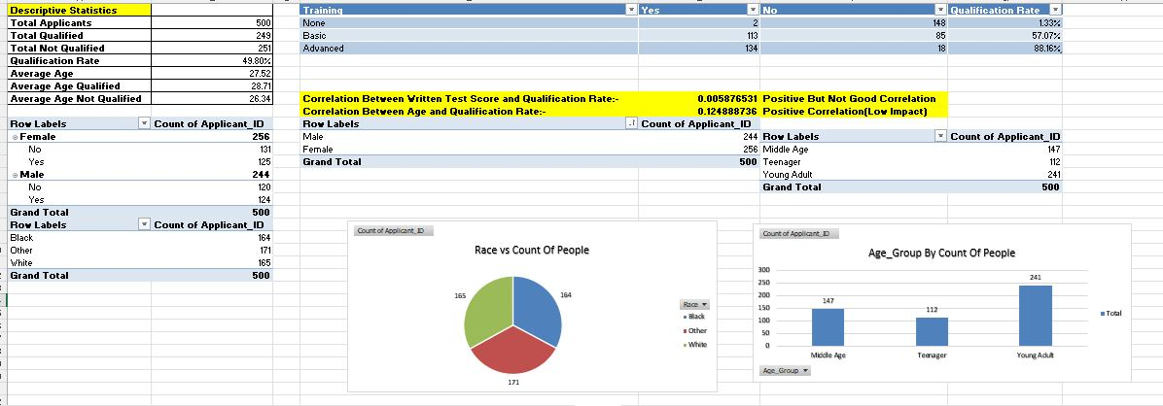
Exploratory Data Analysis:-

Slide 9
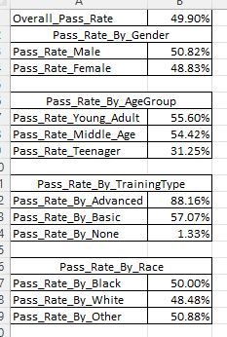
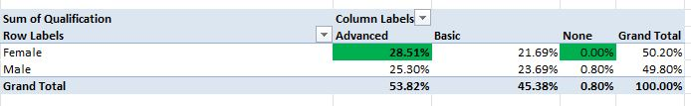
Exploratory Data Analysis:-

Slide 10
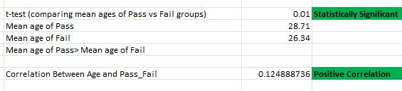
Relationship between age & Pass-Fail group
A T test was conducted between ages of passed people and failed people and we got that the age significantly influences the outcome (p = 0.005). On average, candidates who passed the road test were older (28.7 years) compared to those who failed (26.3 years). This suggests maturity/experience may improve success rates.

Slide 11
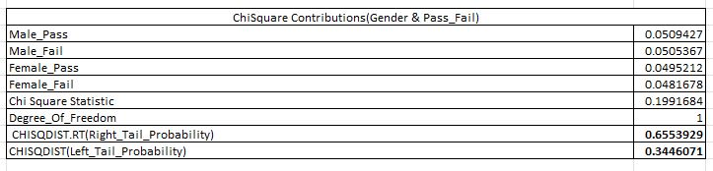
Chi-Square Outcome between gender and pass/fail
Chi Square Test between Gender vs Pass-Fail:- Chi Square test was conducted between Gender vs Pass-Fail and we got that there is no significant relationship between gender and pass/fail outcome.

Slide 12
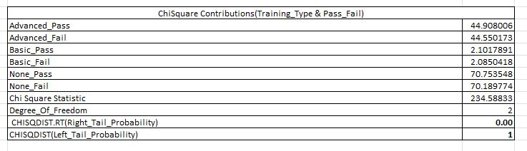
Chi-Square Outcome between training type and pass/fail
Chi-Square Test between Training type and pass/fail: Chi Square test was conducted between Training Type and Pass/Fail and we got that there is strong and statistically significant relationship between Training_Type and pass/fail outcome.

Slide 13
Logistic Regression – Predicting Road Test Success
Logistic regression model built to predict Pass/ Fail outcome.
Predictor variables used: Gender ,Age , Training_Advanced , Training_Basic , Theory Test, Reaction time, Signals, Speed Control, Road_signs, Mirror usage ,Confidence, Parking, Night_Drive, Steer_Control.
Categorical variables converted to dummy variables (Males=1, Females=0,In Reaction_Fast Fast=1,Slow & Average=0 and In Reaction_Slow Slow=1, Fast & Average=0).
Model assigns a probability of passing (0-1) for each candidate.
Cut-off is set in a dynamic way in excel to classify “Pass” Vs “Fail”.
By using the Maximum Likelihood Estimation Method(MLE) we got that Training Type Advanced and Basic are the main deciding factors for whether a person will pass or fail in the driving test.
A confusion matrix is set to count True Positive , True Negative , False Positive , False Negative and from that accuracy , precision and F1 score is also calculated where we minimized False Positives as we can’t afford to mark inefficient drivers as an efficient drivers.
Here cutoffs are set in excel in a dynamic way so that whenever we will change the cutoff TP, TN, FP, FN, Accuracy, Precision and F1 score will change automatically when we will refresh the pivot table.

Slide 14
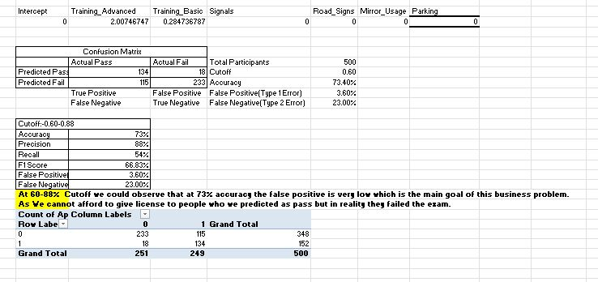
The Confusion Matrix

Slide 15
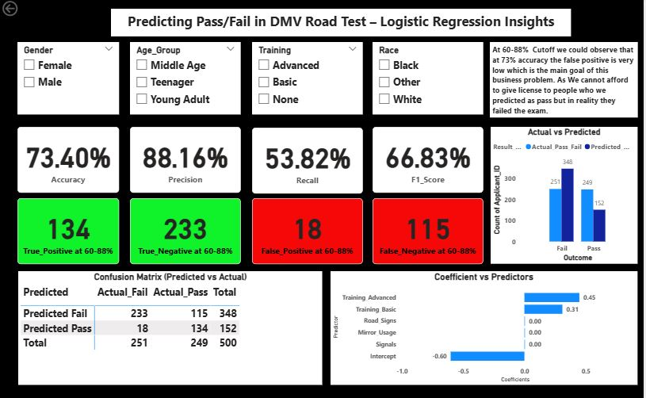
Prediction model Outcome

Slide 16
Data Analysis and Visualization:-
After data cleaning ,pre processing, data analysis using statistical techniques all the excel files are loaded into Power Bi. Then with the help of Power Bi DAX formulas , Visualization Charts and other important features of Power Bi Three Dashboards were created to address all the questions in problem statement.
📊 Dashboard 1:DMV Road Test Analysis: Qualification Patterns by Demographics and Training
📊 Dashboard 2:Training & Demographic Influence on Qualification Outcomes
📊 Dashboard3:Predicting Pass/Fail in DMV Road Test Logistic Regression Insights

Slide 17
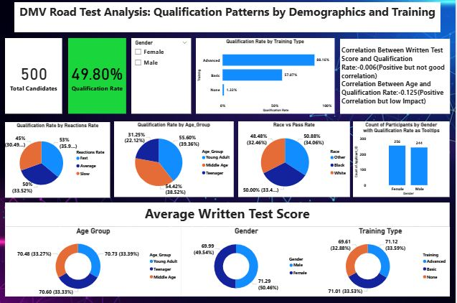
📊 Dashboard 1:DMV Road Test Analysis: Qualification Patterns by Demographics and Training

Slide 18
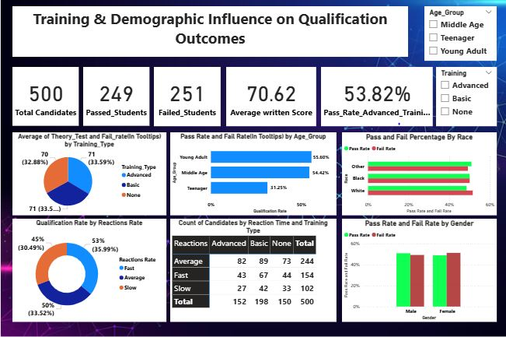
📊 Dashboard 2:Training & Demographic Influence on Qualification Outcomes

Slide 19

📊Dashboard3:Predicting Pass/Fail in DMV Road Test Logistic Regression Insights

Slide 20
Findings
Training Type Advanced has the highest qualification rate(88.16%) and qualification rate is highest among males(50.82%) and Fail rate is highest among females(51.17%).
Qualification rate is highest for candidates whose reaction type is fast(35.99%).
Middle age group(30-50 Years) has the highest qualification rate(39.36%) & Fail rate is highest among Teenagers(16-19 Years).
Race others has the highest qualification rate(34.06%) & Fail rate is highest among White race.
Average written score in Young Adult(20-30), Gender and Training Type Advanced.
Correlation between age and qualification rate shows positive correlation that means with maturity qualification rate increases.
Average theory test is highest among people who has taken Training Advanced type.
People who took Training Type Basic has highest number of people under reaction type basic.

Slide 21
Findings
A predictive model is formed and from that we got that People who have taken Training Type Advanced and Training Type Basic are more likely to pass the exam.
At 60-88% Cutoff we observed that at 73% accuracy the false positive is very low which is the main goal of this business problem. As here I have tried to minimize the number of people who were predicted as pass but actually failed in the exam.

Slide 22
Failure Reasons
Skill Indicator | Interpretation | Failure Reason
Signals | Positive driver of passing | Not giving signals correctly leads to failure
Road Signs | Positive driver of passing | Not following road signs causes failure
Mirror Usage | Positive driver of passing | Not using mirrors properly leads to failure
Parking | Positive driver of passing | Not able to park properly leads to failure
Reaction_Fast | Positive driver of passing | Not able to react quickly leads to failure

Slide 23
Recommendations
Promote Advanced Training Programs
Applicants who took advanced training had the highest chance of passing. Increasing access to such programs will improve pass rates.
Encourage Basic Training for Beginners
Even basic training gives applicants a better chance of success compared to no training. Making this more widely available can reduce failures.
Focus on Key Driving Skills
Indicators like signals, road signs, and mirror usage showed significant impact on outcomes. Extra practice and testing in these areas can raise success rates.
Regularly Monitor Results with Dashboards
An interactive dashboard helps DMV officials track pass rates by gender, age, and training type. This makes it easier to spot trends and adjust training programs quickly.
Track Demographic Trends
While gender showed no significant impact , age and training choices did. Monitoring subgroups performance ensures fairness and highlights were extra support is needed.

Slide 24
Limitations
Observational data — causality not proven.
→ We only looked at existing data. We have seen patterns (like training and pass rates), but we can’t be 100% sure that training causes higher pass rates. There may be other reasons.
Training selection may be endogenous (people who opt for training may differ)
→ The people who choose “advanced training” might already be more motivated or better prepared than those who don’t. So, their higher pass rate may not be only because of the training.
Possible measurement error in skill indicators
→ Some information might not be fully accurate (for example, if skills or training were recorded incorrectly, or if people reported it themselves instead of being observed).
Model may omit other relevant variables
→ We didn’t have all possible factors (like prior driving experience, confidence level, or family income). These could also influence pass/fail results but were not included in the model.

